Slide 1
HK97 Results

Slide 2
Results
T=7 Architectures
5uu5 - Hexagonal
6xgq – Trihex
3j4u – Trihex

Slide 3
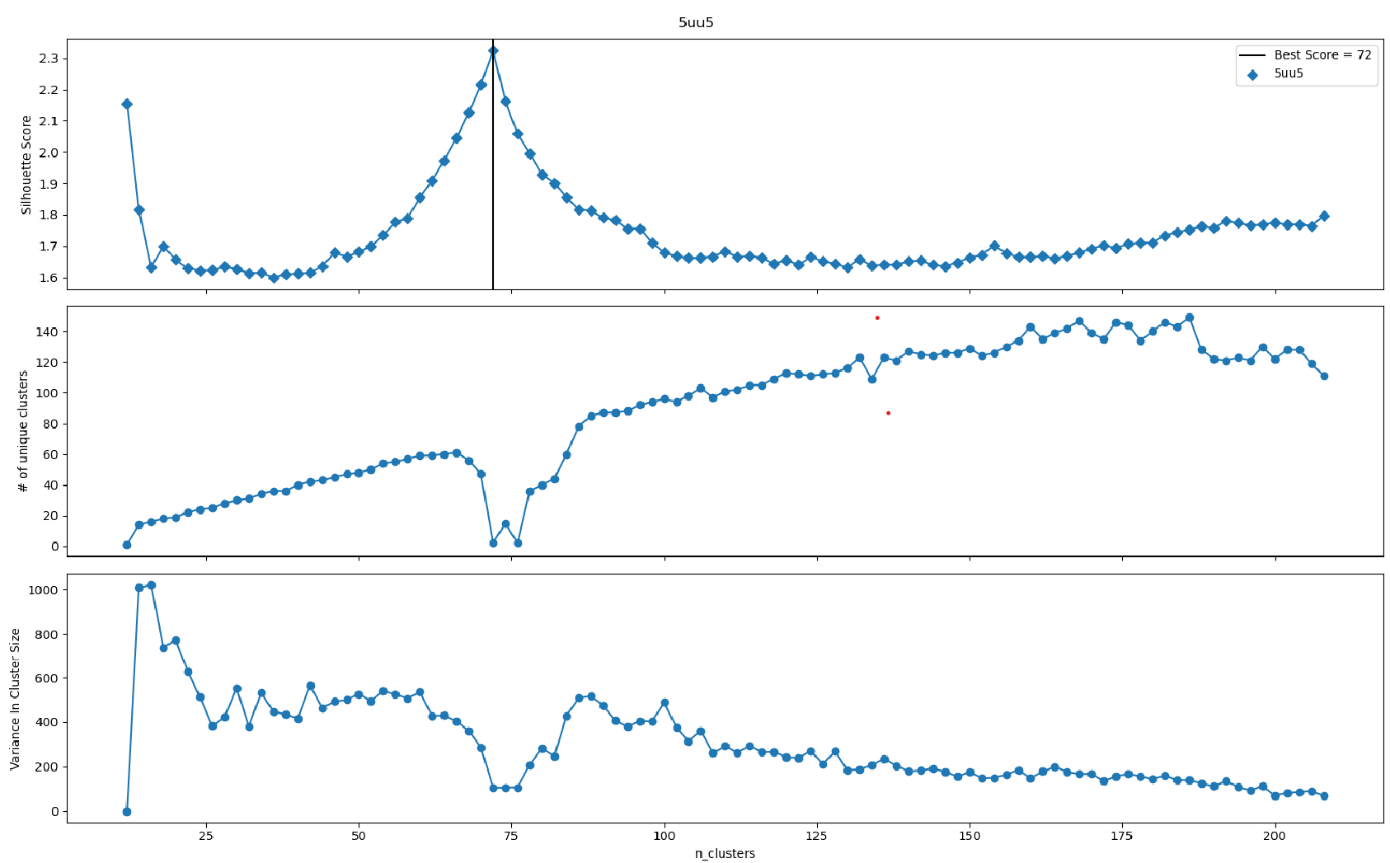
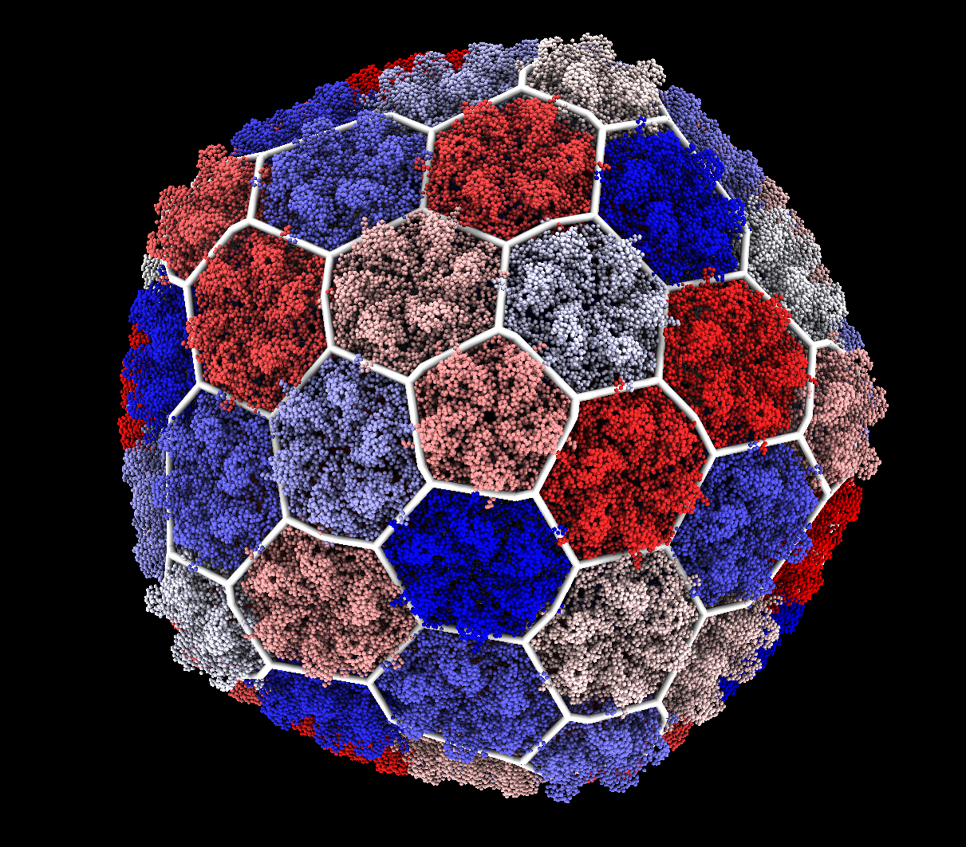
P22 Mature – 5UU5

Slide 4
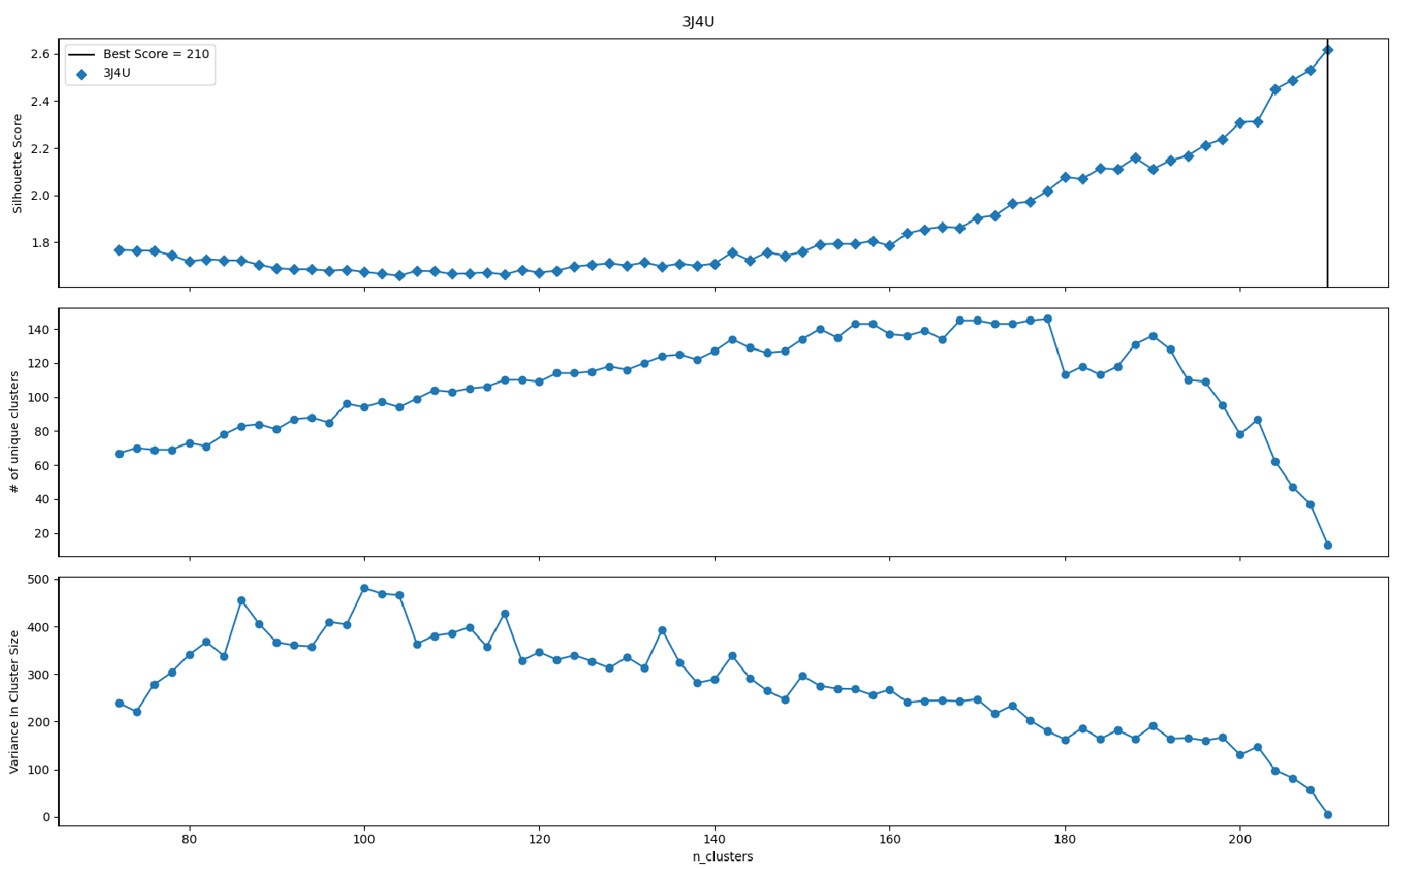
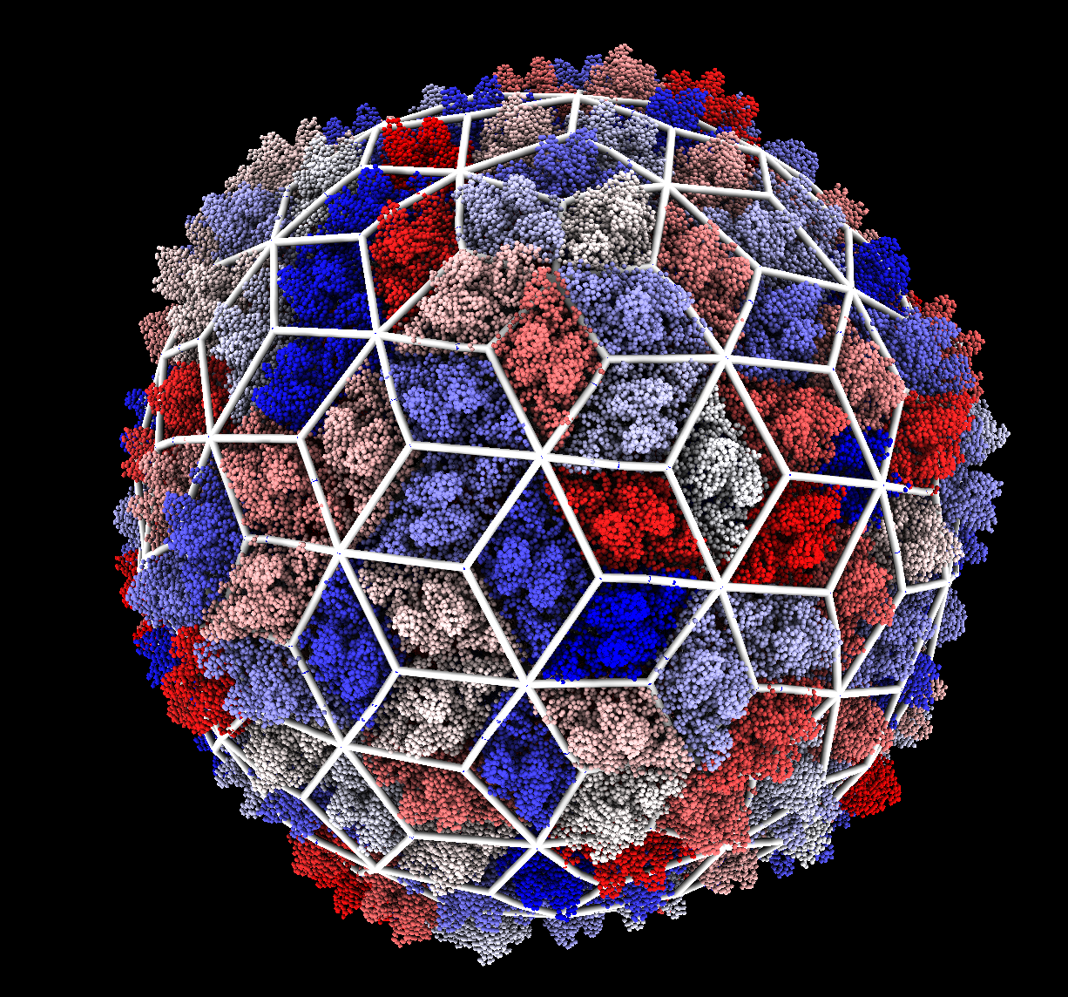
3J4U – Bordetella Bacteriophage Imperfect

Slide 5
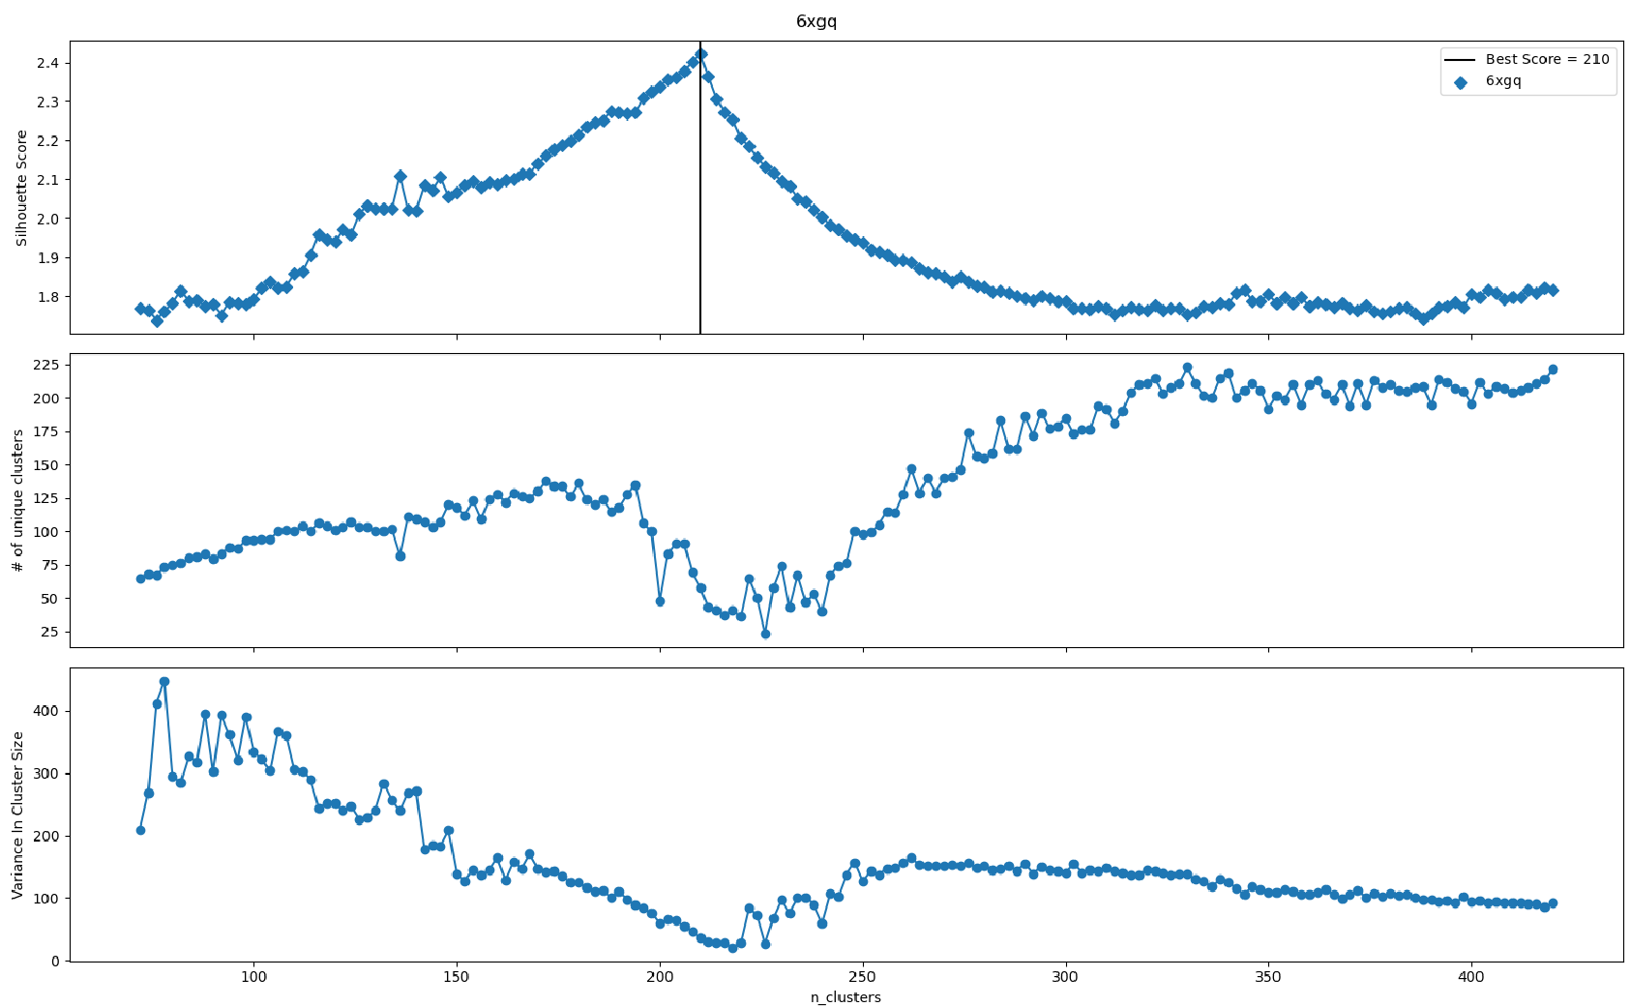
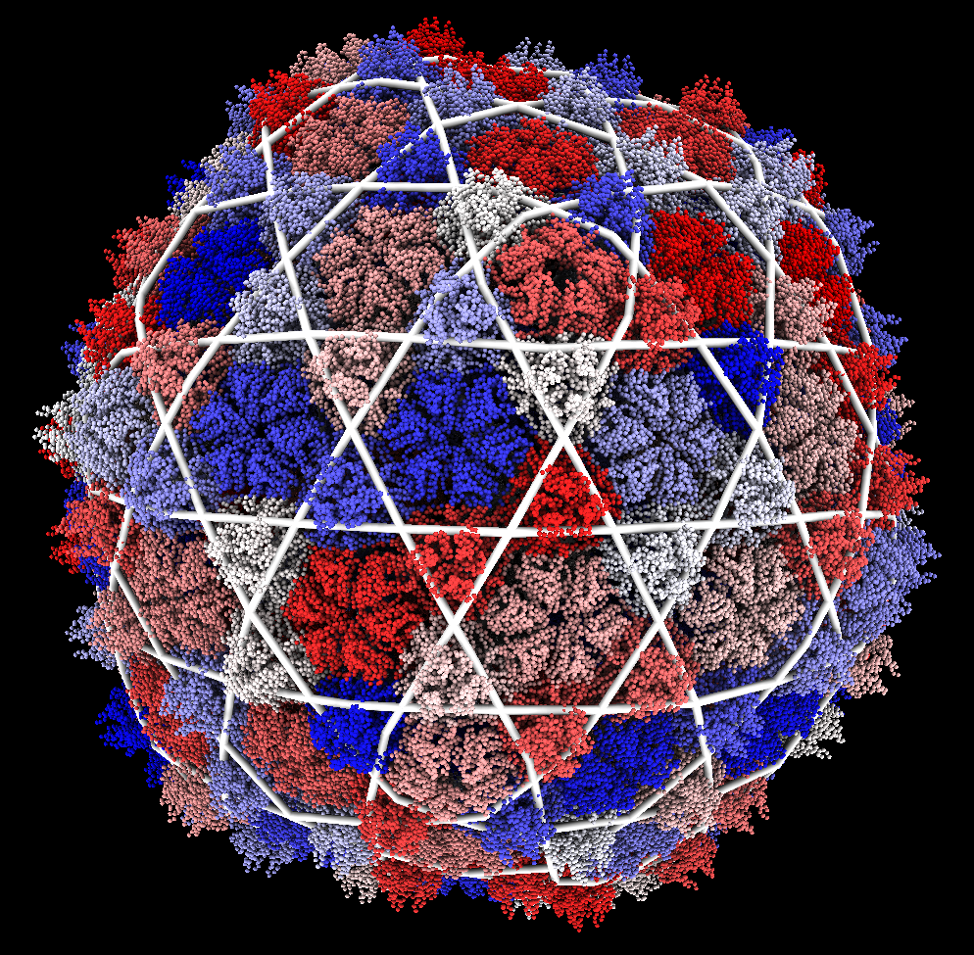
6xgq - YSD1 Bacteriophage Imperfect

Slide 6
Discussion
P22 lacked reinforcement proteins and was labelled as hexagonal
Bordetella and Phage YSD1 had reinforcement proteins around the local 2-fold and 3-fold axes respectively and were labeled as trihex-dual and trihex.
This suggests the presence and location of reinforcement proteins could determine lattice structure.
Both Bordatella and YSD1 had error in their label assignments. The tool becomes less accurate at a large number of clusters.

